Slide 1
C♯ this._course.Dispose();
Rasmus Lystrøm
Associate Professor
ITU
rnie@itu.dk

Slide 2
Agenda
Security Recap
DevOps
Exam questions

Slide 3
Security Recap

Slide 4
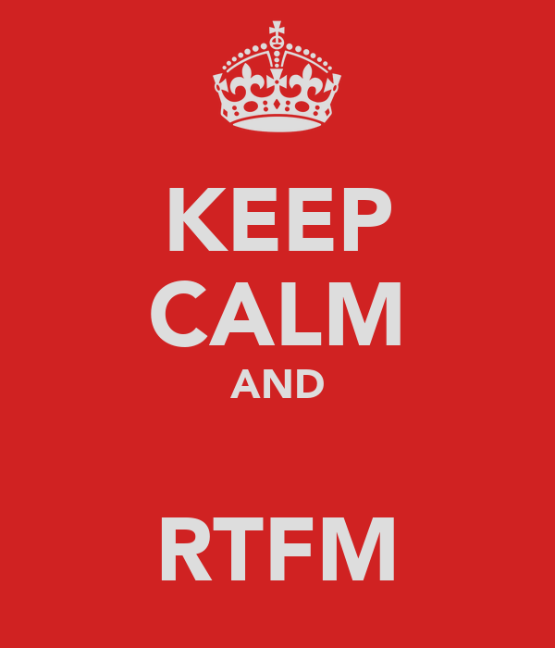
When in doubt; read the docs!
Source: http://keepcalm-o-matic.co.uk/p/keep-calm-and-rtfm-123

Slide 5
DevOps

Slide 6
DevOps
DevOps is a set of practices that automates the processes between software development and IT teams, in order that they can build, test, and release software faster and more reliably. The concept of DevOps is founded on building a culture of collaboration between teams that historically functioned in relative siloes.
Source: https://www.atlassian.com/devops

Slide 7


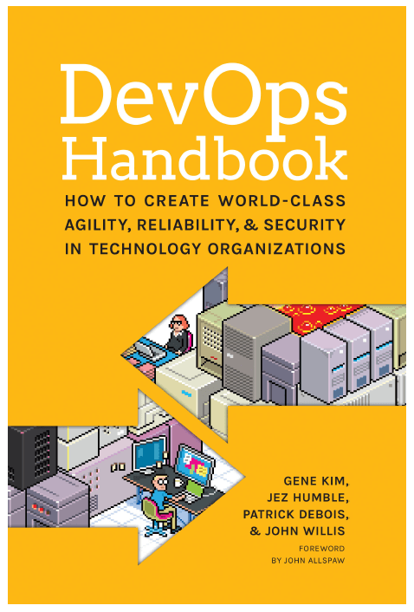
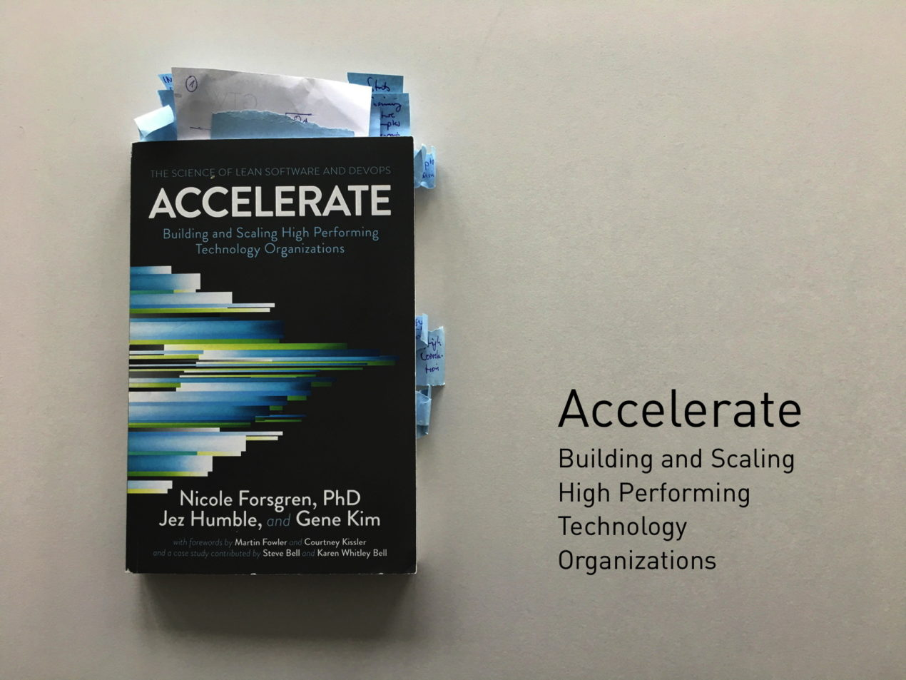
Books

Slide 8
Continuous Integration

Slide 9
Continuous Integration
Continuous integration (CI) is the practice of automating the integration of code changes from multiple contributors into a single software project. The CI process is comprised of automatic tools that assert the new code's correctness before integration.

Slide 10
Trunk Based Development

Slide 11
Trunk Based Development
A source-control branching model, where developers collaborate on code in a single branch called ‘trunk’ *, resist any pressure to create other long-lived development branches by employing documented techniques. They therefore avoid merge hell, do not break the build, and live happily ever after.
* master, in Git nomenclature
Source: https://trunkbaseddevelopment.com/

Slide 12
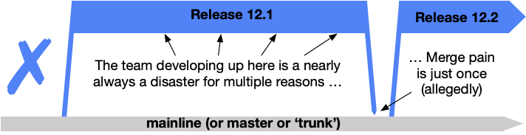
Shared branches off mainline/master/trunk are bad at any release cadence

Slide 13
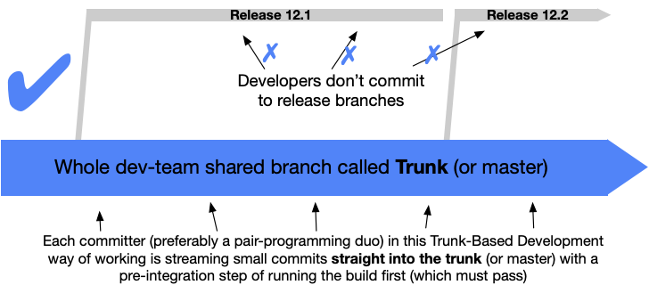
Trunk Based Development

Slide 14
Branching strategy vs. tactics
Short-lived < 1 day
No strategy!

Slide 15

Azure DevOps

Slide 16
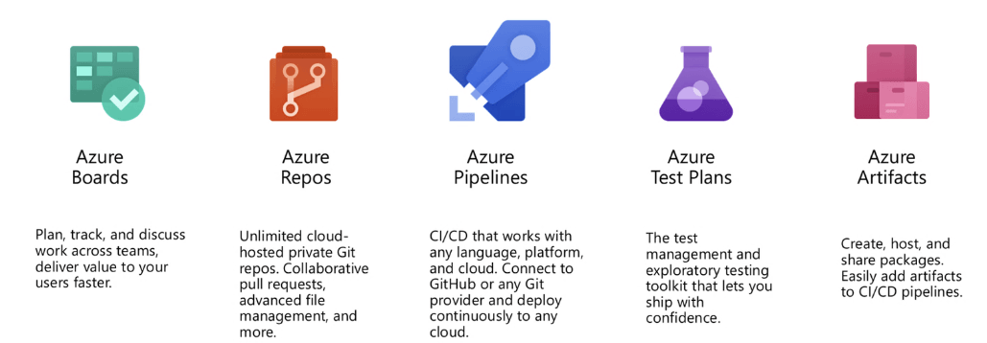
Azure DevOps

Slide 17
Azure DevOps
Demo

Slide 18
Continuous Integration Trunk Based Development
Demo

Slide 19
Continuous Delivery

Slide 20
Continuous Delivery
Continuous delivery is an approach where teams release quality products frequently and predictably from source code repository to production in an automated fashion.

Slide 21
Continuous Deployment

Slide 22
Infrastructure as Code

Slide 23
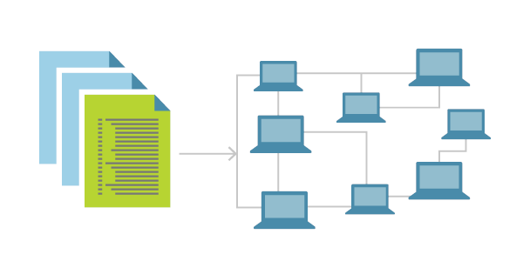
Infrastructure as Code
Infrastructure as Code (IaC) is the management of infrastructure (networks, virtual machines, load balancers, and connection topology) in a descriptive model, using the same versioning as DevOps team uses for source code.
Idempotent
IaC is a key DevOps practice and is used in conjunction with CD
Source: https://docs.microsoft.com/en-us/azure/devops/learn/what-is-infrastructure-as-code

Slide 24

Infrastructure as Code Tools for Microsoft Azure
Azure PowerShell
Azure CLI
ARM Templates
Terraform

Slide 25
Continuous Delivery and Deployment Infrastructure as Code
Demo

